Slide 1
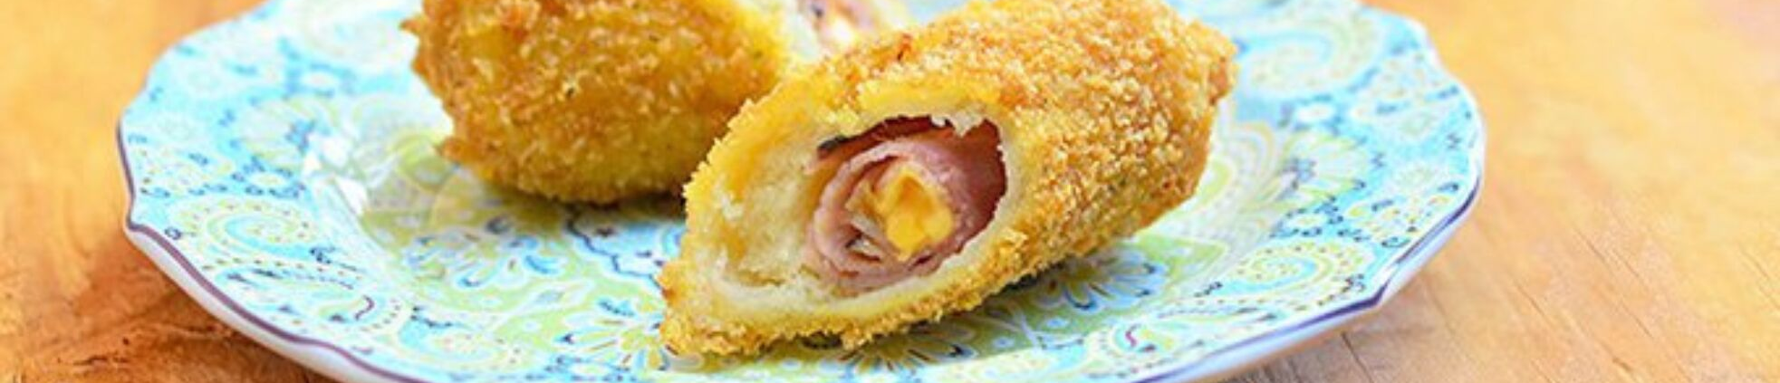
GROUP FOUR PRESENTS
BREAD ROLLS
EMPOWERMENT TECHNOLOGIES

Slide 2
Presentation Outline
Points of Discussion
About The Product
Ingredients
Procedure
Survey Results

Slide 3
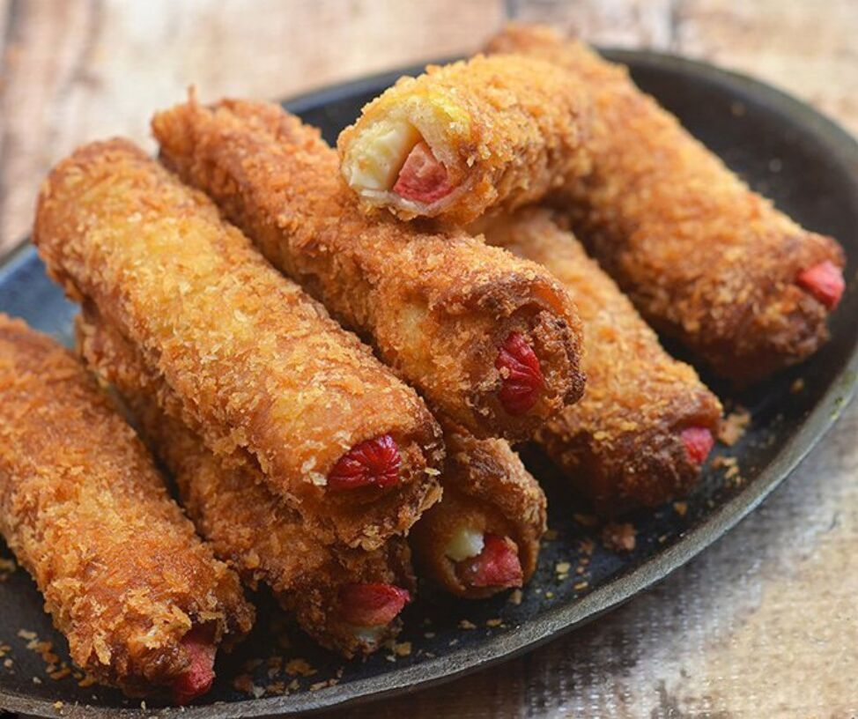
Bread Rolls
About The Product
Bread rolls are a popular Pinoy snack and different recipe versions abound among Filipinos. Golden, crunchy and stuffed with meaty hot dogs, ham and melty cheese, they’re a hearty snack or appetizer kids and adults alike will love!

Slide 4
HAM & CHEESE
HOT DOG & CHEESE
Different Bread Rolls
HAM & HOT DOG
HAM, HOT DOG & CHEESE
CHICKEN & CHEESE

Slide 5
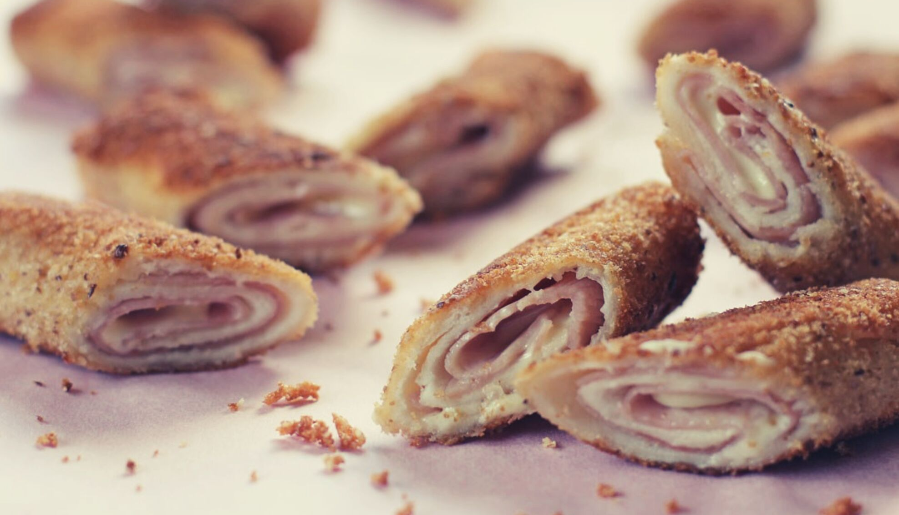
HAM & HOT DOG
BREAD ROLLS
BUDGET FRIENDLY NA NAKAKABUSOG PA

Slide 6
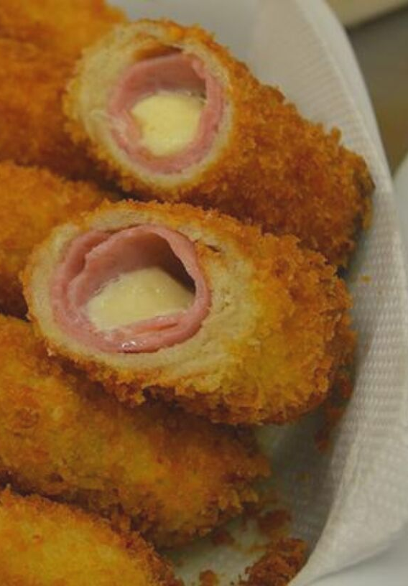

FOR ONLY P10
If you’re looking for the perfect after-school treat for the kiddos or fun appetizers for the adults, these stuffed bread rolls are it! Golden, crunchy and filled with meaty hot dogs and ham on the inside, they're sure to be hit.

Slide 7
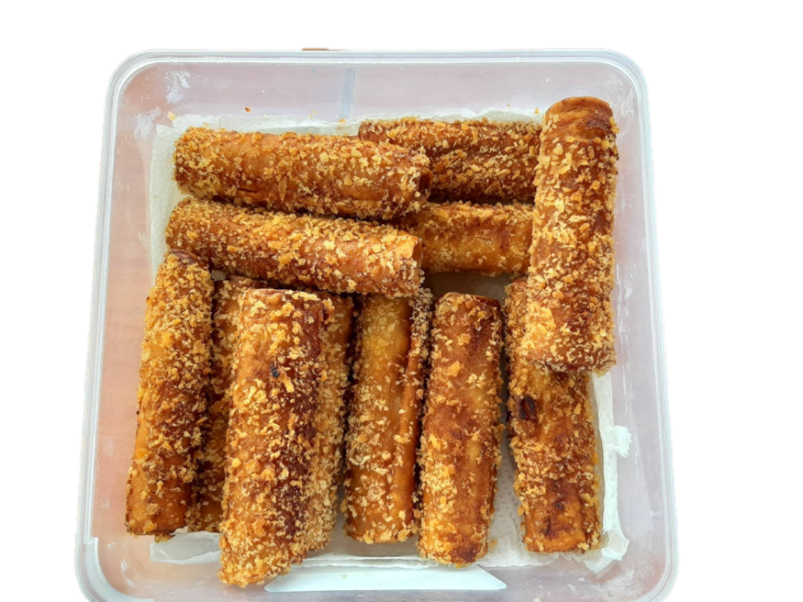
Ham & Hot Dog
Bread Rolls
Ingredients and Procedure.

Slide 8



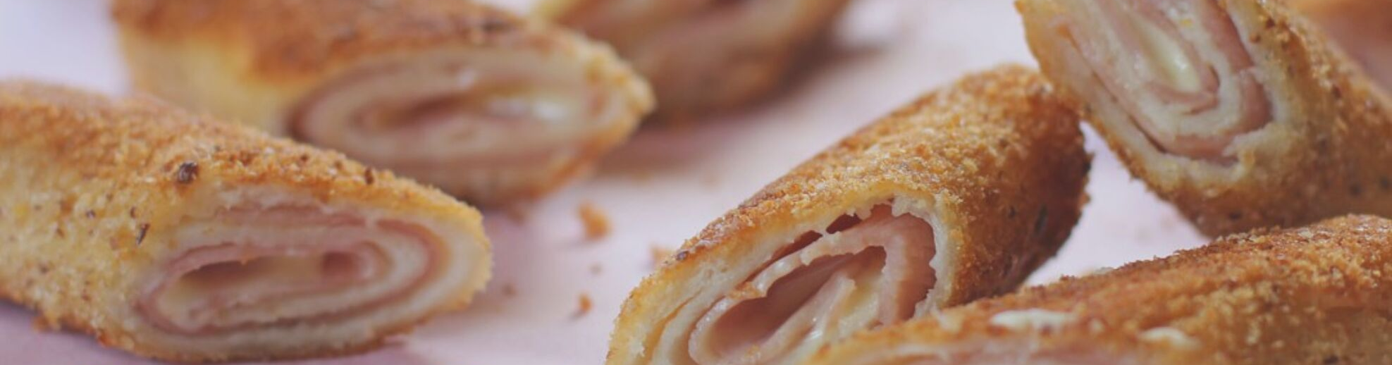


INFORMATION
PREP TIME
COOK TIME
CHILL
TOTAL TIME
15 mins
5 mins
5 mins
20 mins
SERVINGS
CALORIES
183
kcal
15

Slide 9







INGREDIENTS
15 slices of white bread
15 slices of ham
4 hot dogs, cut into 4 strips
2 eggs
bread crumbs
tomato sauce
oil

Slide 10
Common Sense Procedure
Direct to the point.
FLATTEN THE BREAD WITH ROLLING PIN
SPREAD TOMATO SAUCE AT THE TOP
PUT HAM & HOT DOG, THEN ROLL TO SEAL
DIP IN WHISKED EGG
DIP IN BREAD CRUMBS
Then deep fry!

Slide 11
3.93
QUALITY
3.73
Quality, Taste & Presentation
TASTE
3.67
The average rating with a scale of 1 to 4.
PRESENTATION
NO
ZERO
Satisfied? Recommended?
YES
YES OR NO?
FIFTEEN

Slide 12
PHP 15 Below
PHP 16-25
14
1

Slide 13
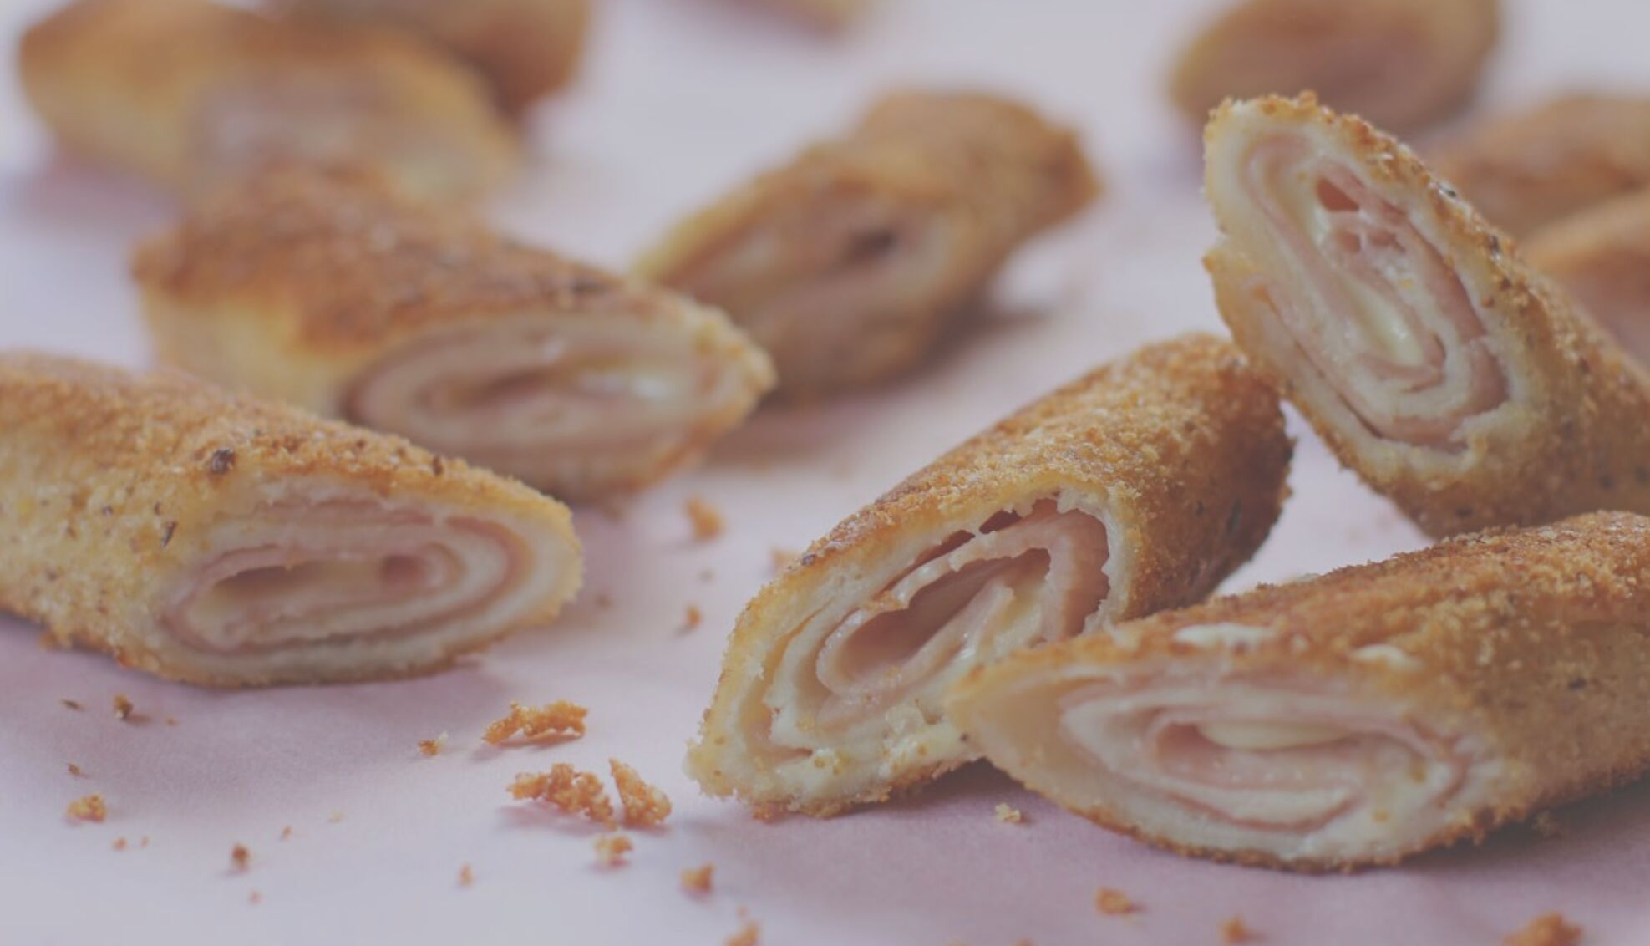
Food for Thought
YOUR DIET IS A BANK ACCOUNT. GOOD FOOD CHOICES ARE GOOD INVESTMENTS.
BETHENNY FRANKEL

